Slide 1
Preliminary Baseline 420 MHZ Celestial Drift Scan Survey
December 2016
Dr. Rich Russel
Deep Space Exploration Society

Slide 2
Drift Scan at 420 MHz
Skypipe can plot using LMST
420 MHz is lowest UHF frequency the TS2000 can receive
13 element circularly polarized beam antenna on Az-El mount
Star Charts used to determine antenna pointing on celestial sphere
420 MHz is associated with cosmic ray particles in which the electrons emit synchrotron radiation as they spiral along the galactic magnetic field lines, part of the Interstellar Medium (ISM)
Note: 1st try at the survey – use to compare with follow-on surveys
Observatory
Colorado Springs, CO
6-11 December 2016
TS 2000 Transceiver (420 MHz CW)
Radio Skypipe recorder
Antenna (UHF 13 element circularly polarized) on Az-El Mount
Procedure
Antenna pointed south (meridian) and changed in elevation to achieve declination goal
TS 2000 tuned to 420 MHz
Audio output sent to PC with Radio Skypipe running
Data recorded using X-axis as LMST (right ascension)
Results compared to star charts

Slide 3
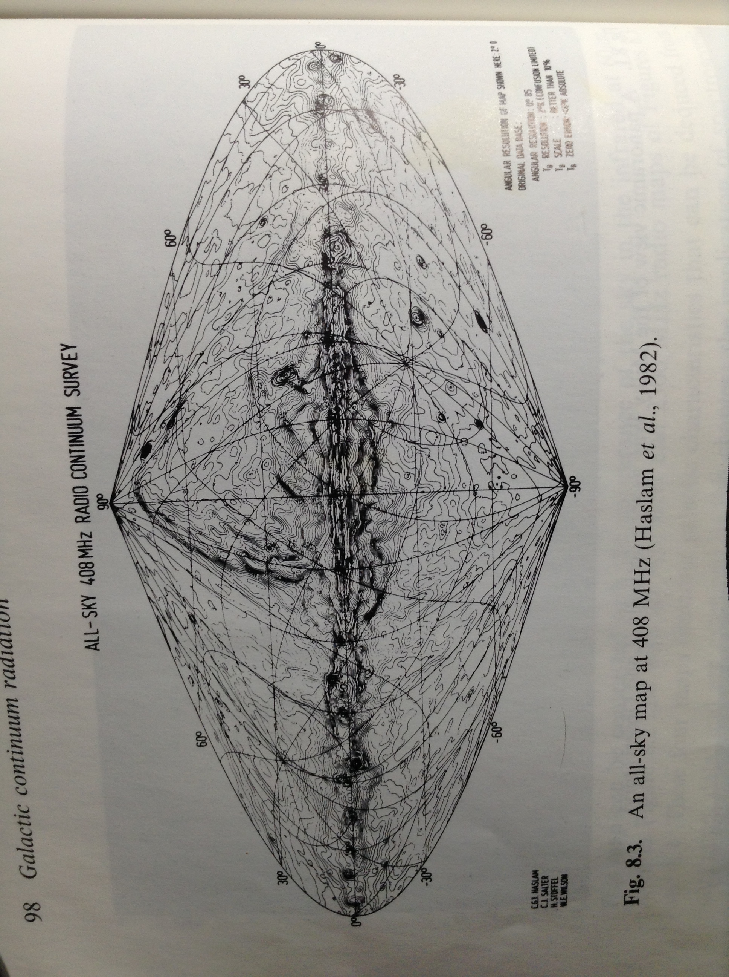
Goal – Reproduce 408 MHz Survey
Source:
An Introduction to Radio Astronomy, Burke, and Graham-Smith, 1997 Cambridge University Press

Slide 4
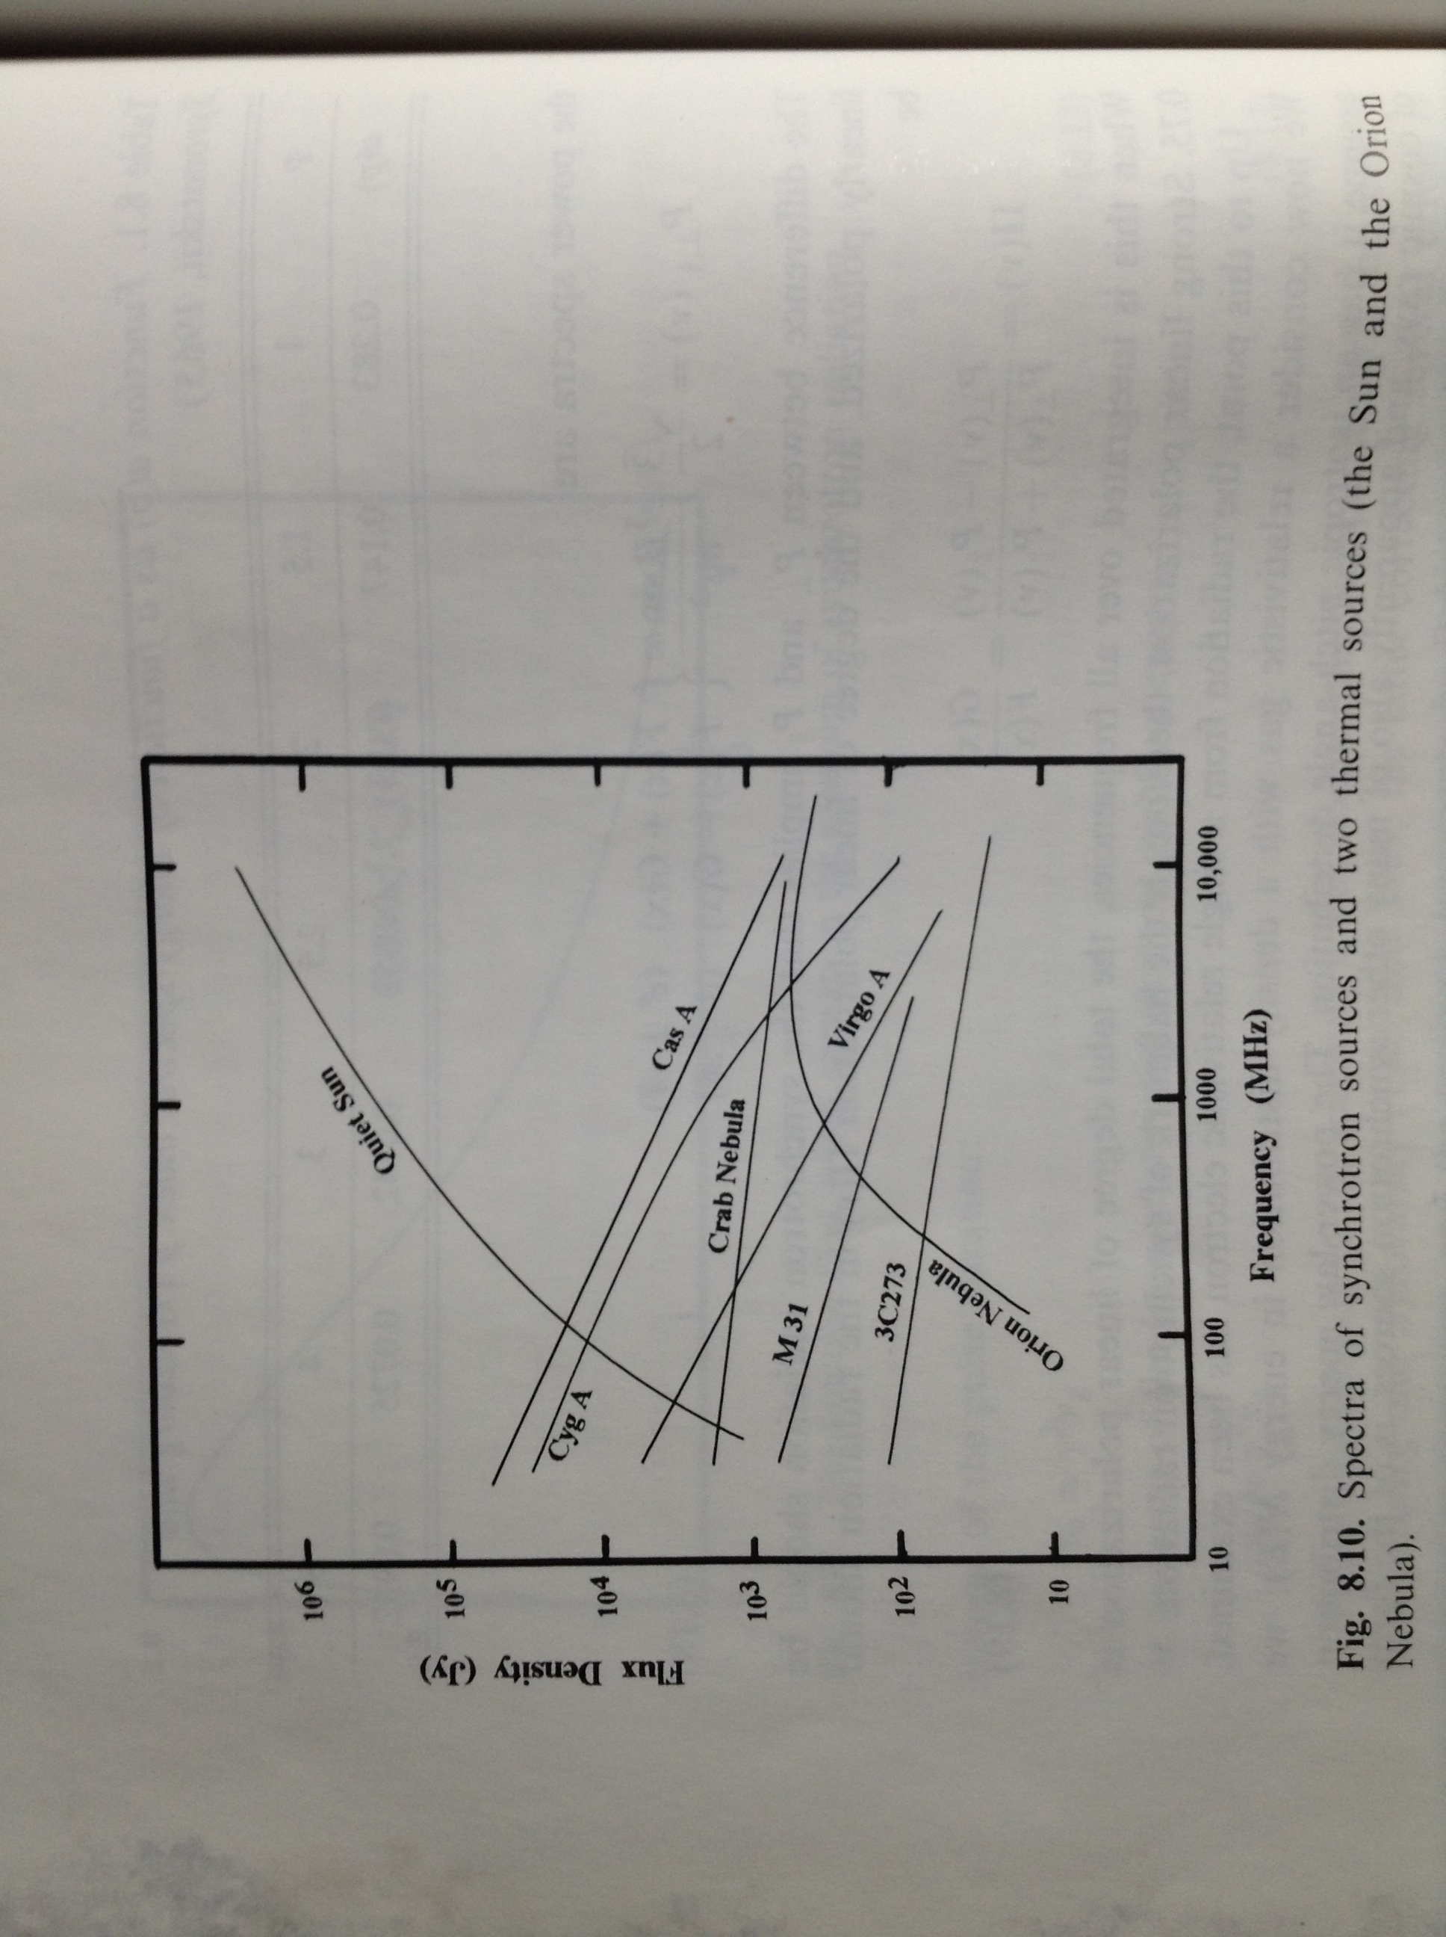
Frequencies that can be detected
Source:
An Introduction to Radio Astronomy, Burke, and Graham-Smith, 1997 Cambridge University Press

Slide 5
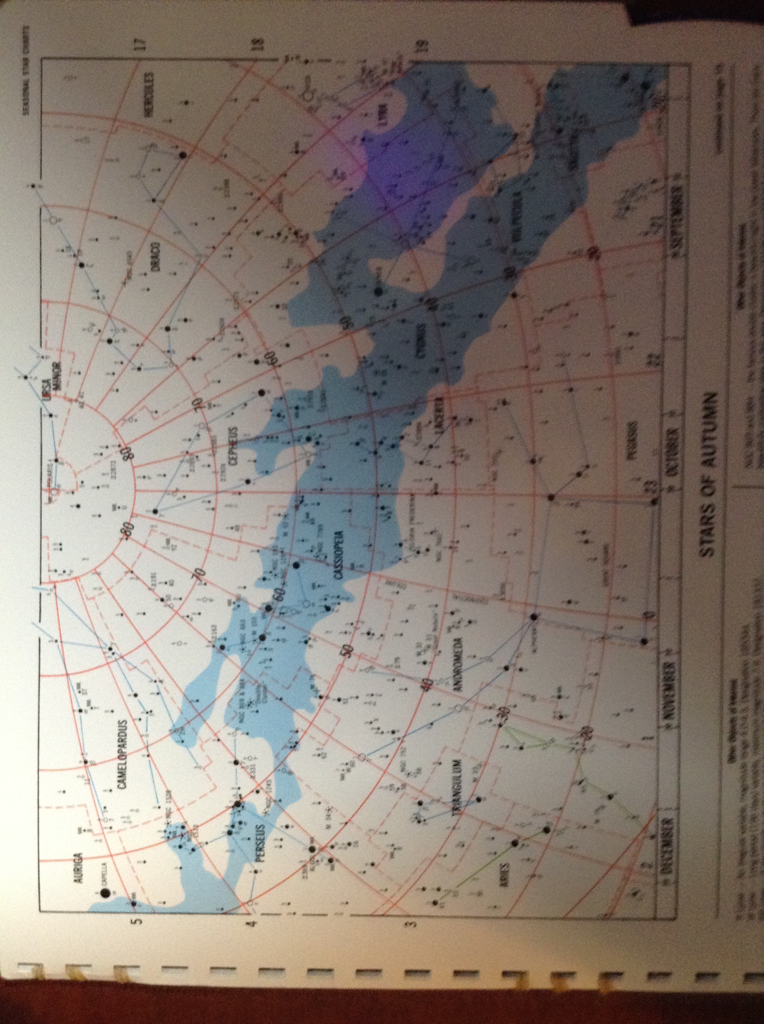
Star Chart
Source:
Seasonal Star Charts, 2007 Hubbard Scientific
Declination
Right Ascension (LMST)

Slide 6
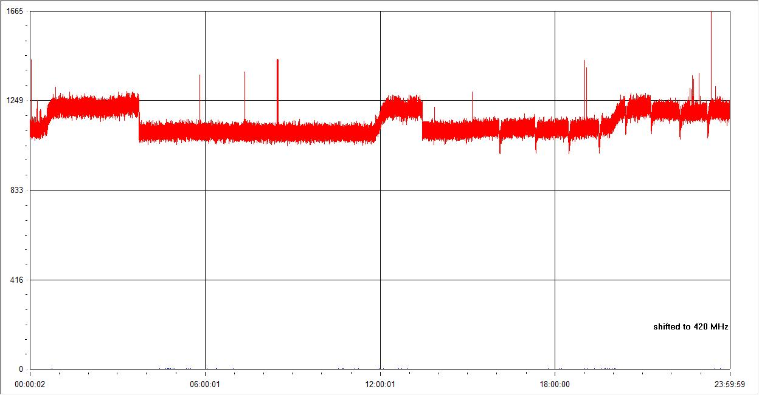
68.5 Declination– 420 MHz Example of Possible detections
Possible transients
Possible detections
LMST (Right Ascension)
Possible detections will have a width due to beam-width of the antenna
Transients do not have width
Check with star charts or other sources to verify detections

Slide 7
LMST (Right Ascension)
A
A
B
68.5 Declination
Cassiopeia
58.5 Declination
C
D
E
48.5 Declination
M31
38.5 Declination
M1 Crab Nebula
28.5 Declination
LMST (Right Ascension)

Slide 8
LMST (Right Ascension)
28.5 Declination
(Duplicate)
M45 Pleides
F
G
18.5 Declination
H
8.5 Declination
I
J
K
L
-1.5 Declination
LMST (Right Ascension)

Slide 9
LMST (Right Ascension)
-1.5 Declination
(Duplicate)
-11.5 Declination
M
-21.5 Declination
-31.5 Declination
LMST (Right Ascension)

Slide 10
Data Summary

Slide 11
Results Plotted Against Known Sources
Declination
Right Ascension

Slide 12
Next Steps
Procedure works well
Improve antenna system
Preamp
2nd antenna (interferometer)
Calibrate with noise source
Calibrate pointing accuracy
Tune antenna to 420 MHz
Get more detailed star charts for radio astronomy

Slide 13
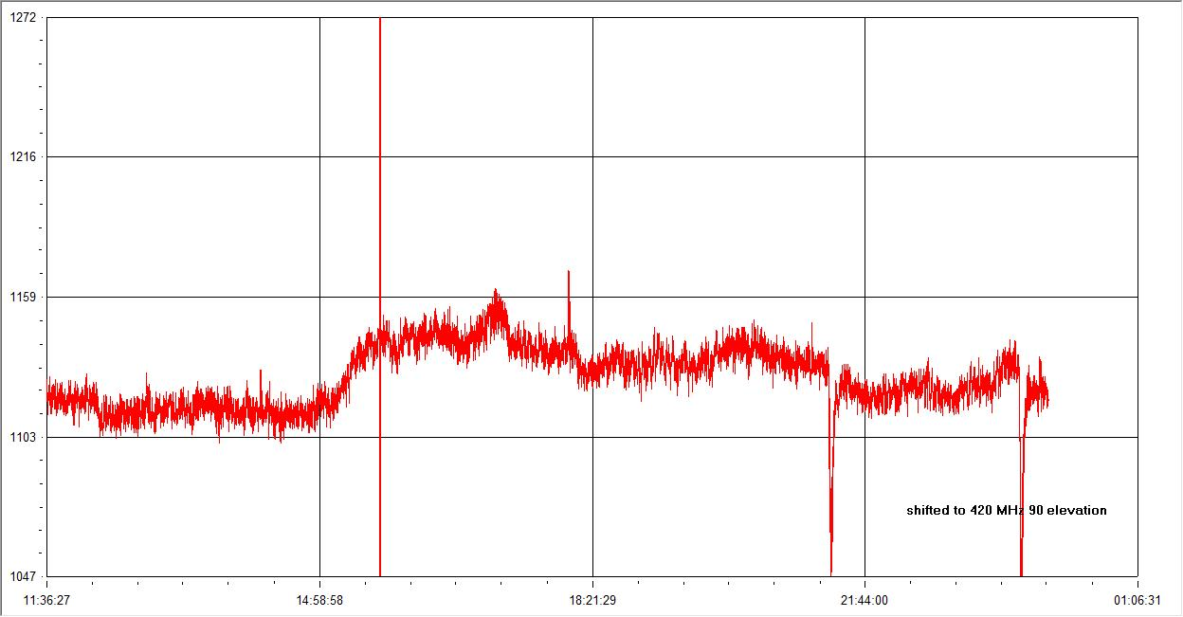
Antenna beamwidth analysis (Sun) 420 MHz
Sun out of view
Sun in view
Max signal (antenna
LMST (Right Ascension)

Slide 14
Antenna Beamwidth– 420 MHz
Start time: 14.97
Full signal time: 15.73
Delta time: 0.76 hrs = 45.6 min
Degrees: 1deg/4min Earth rotation
Degrees of beamwidth: (45.6 min)(1deg/4min)=11.4 degrees beamwidth at 420 MHz
Follow on observations will be made to refine estimate
Antenna details: Hy-Gain Oscar Link Yagi antenna
UB-7030SAT (www.hy-gain.com)
Model# | Frequency Range | F/B Ratio | Gain dBi | Power Input | # Elements | Boom | Wind | Weight
UB-7030SAT | 432-438 MHz | 25 dB | 16.2 dBi | 200W PEP | 30 | 134 inches | 0.7 sq ft | 4 lbs

Slide 15
Experiment Upgrade Plans
Align antenna pointing to Polaris – use laser pointer
Use center frequency of the antenna spec (435 MHz)
Add mast mount preamplifier (Mirage Model KP-2/440 MHz) (mirageamp.com)
Frequency: 430-450 MHz, Gain: 15 dB to 25 dB, Noise: less than 1 dB

Slide 16
Backup Slides

Slide 17
68.5 Declination – 420 MHz
LMST (Right Ascension)

Slide 18
58.5 Declination – 420 MHz
LMST (Right Ascension)

Slide 19
48.5 Declination – 420 MHz
LMST (Right Ascension)

Slide 20
38.5 Declination – 420 MHz
LMST (Right Ascension)

Slide 21
28.5 Declination – 420 MHz
LMST (Right Ascension)

Slide 22
18.5 Declination – 420 MHz
LMST (Right Ascension)

Slide 23
8.5 Declination – 420 MHz
LMST (Right Ascension)

Slide 24
-1.5 Declination – 420 MHz
LMST (Right Ascension)

Slide 25
-11.5 Declination – 420 MHz
LMST (Right Ascension)

Slide 26
-21.5 Declination – 420 MHz
Sun in view
Sun out of view
LMST (Right Ascension)

Slide 27
-31.5 Declination – 420 MHz
Sun in view
Sun out of view
LMST (Right Ascension)

