Slide 1
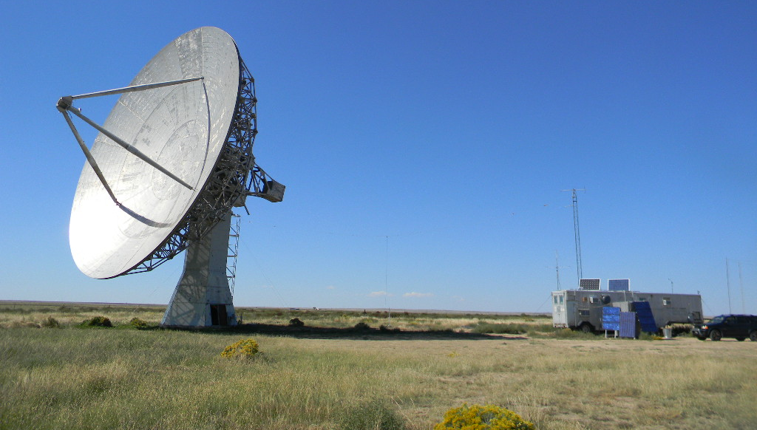
Deep Space Exploration Society
Science Meeting 10-22-2018

Slide 2
Agenda
Overview of 2018 Radio Astronomy Guide
Overview of this weekends observations

Slide 3
Deep Space Exploration Society 2018 Radio Astronomy Guide Revision 3 Overview

Slide 4
October 19-20, 2018 Observation Trip

Slide 5
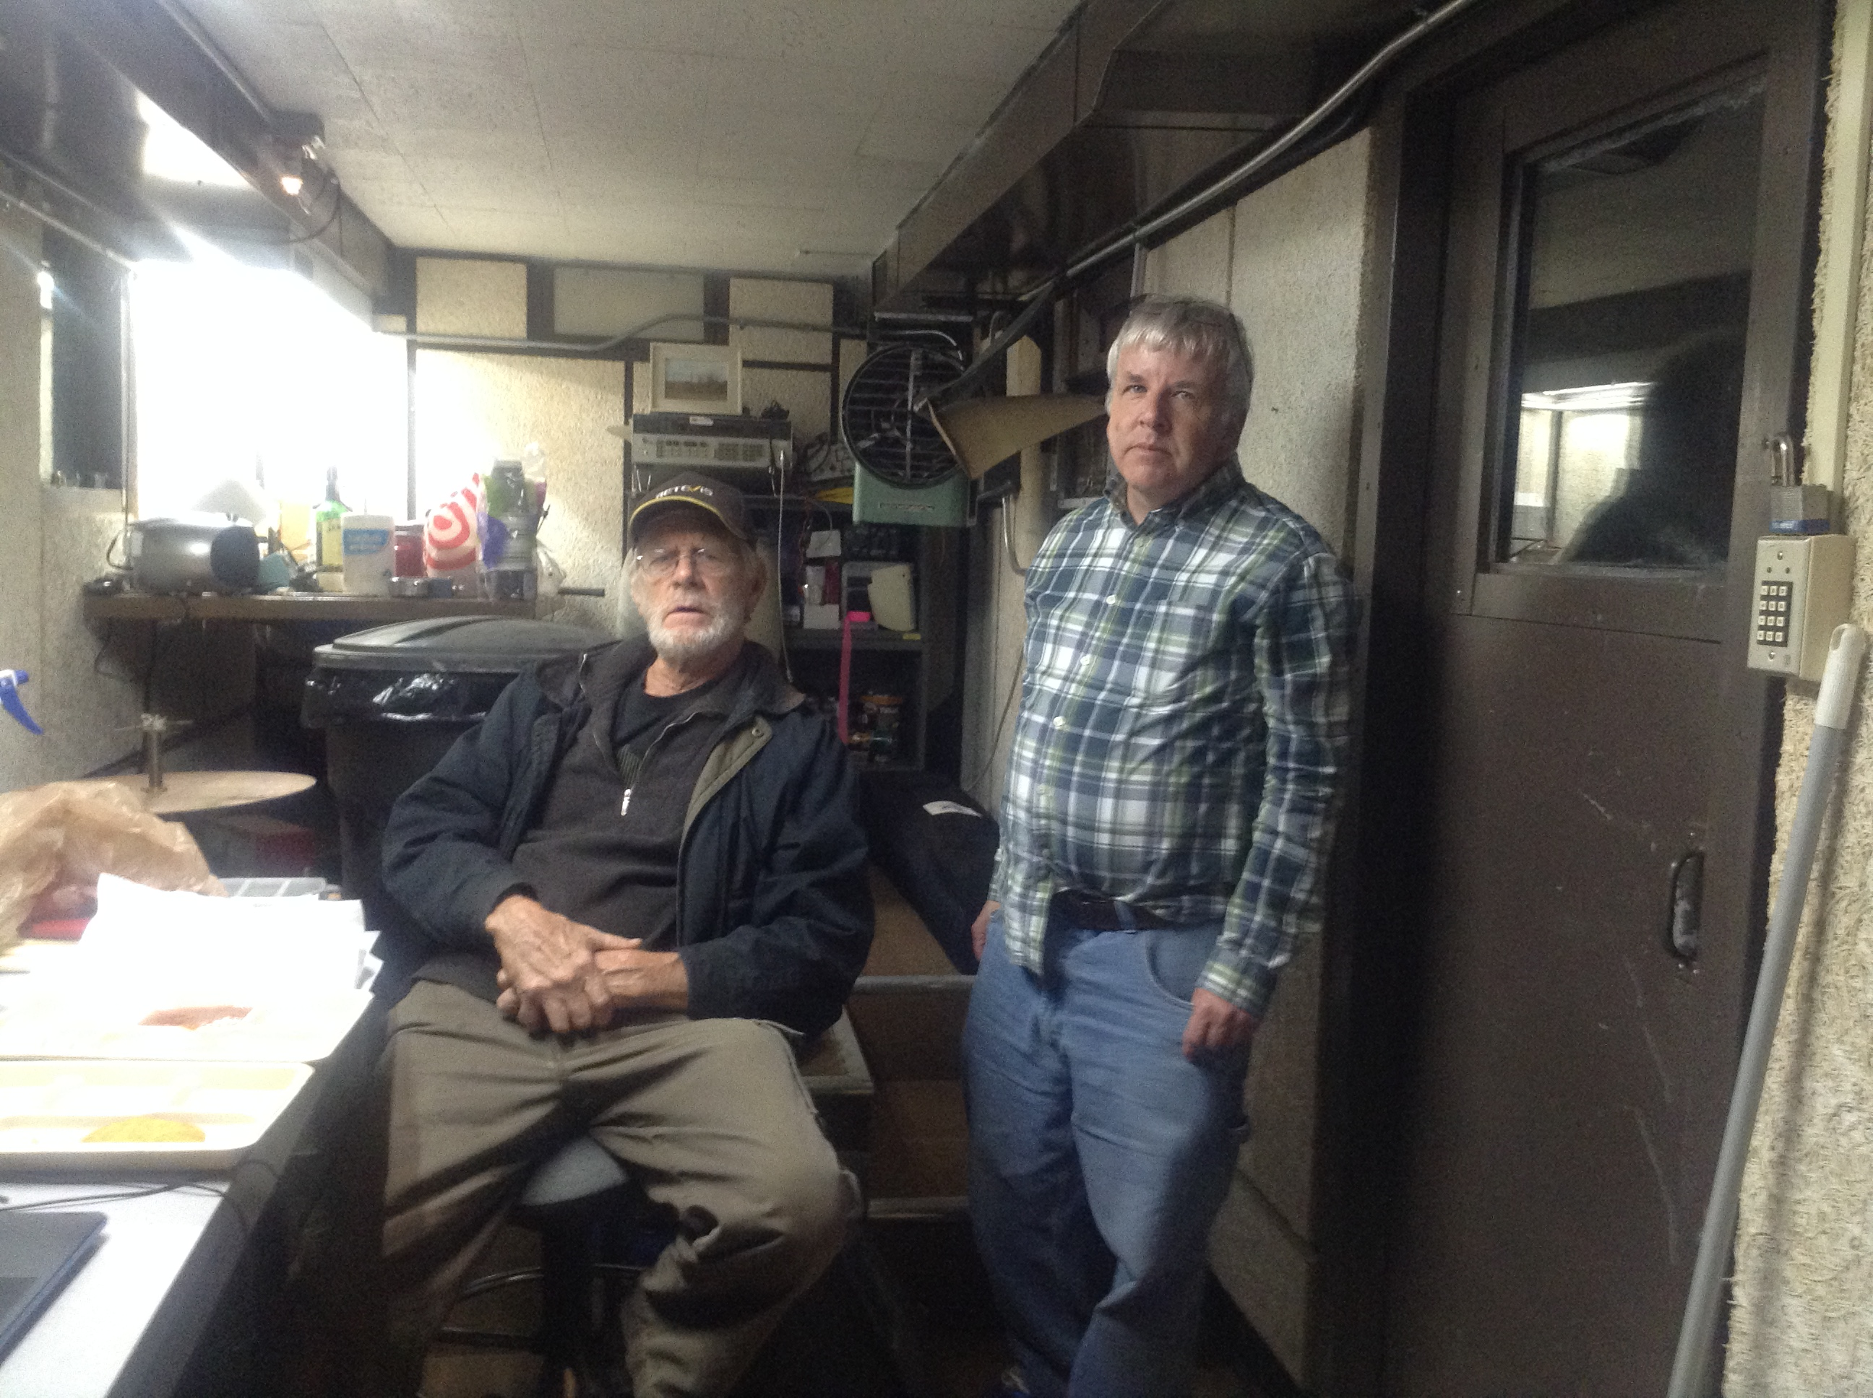
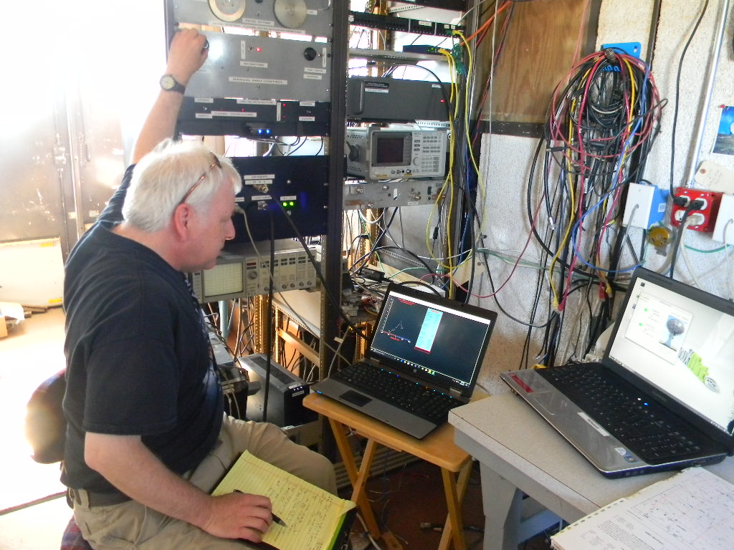
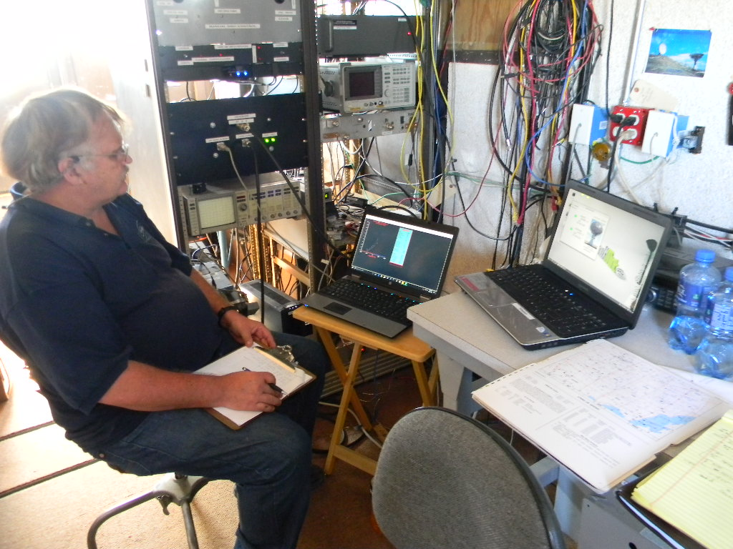
Observation Trip 10-19-18
Observers: Gary Agranat, Paul Berge Richard Russel
Receiver: SpectraCyber with 1420 Mhz. Cavity Filter on 60-foot dish
Pointing System: System 1
Goals: 1) Take Milky Way rotation rate data
2) Observe sources with known Jansky signal levels to determine if a signal calibration level can be
estimated

Slide 6
Equipment Setup
Dish: 60 ft.
Filter: Cavity Filter
Receiver: SpectraCyber
SpectraCyber Setup: (see photo)
Gain: 5
SPEC Integration: 1.0 Second
IF BW: 30 kHz
SPEC Offset V: 3.70V
IF Gain dB: 10
Time/Step: 0.25
Note: We started with Upper KHz at + 500 and Lower KHz at -500 however we started getting sources with high Doppler so we shifted to +-800 Khz

Slide 7
Galactic Rotation Rate Observations
Observe the Galactic Plane at Galactic Latitude 0 and Galactic Longitudes 0, 10, 20, 30, 40, 50, 60, 70, 80, and 90 degrees. This maps the Milky Way’s quadrant 1
Determine the highest Doppler rate of each measurement
Calculate distance to the observed source using the tangent method
Calculate the velocity of the observed source at the calculated distance
The final result is a plot of the Milky Way’s rotation rate at different distances from the galactic center

Slide 8
Galactic Lat 0 Long 0 RA 17h45m37s DEC -28d56m10s

Slide 9
Galactic Lat 0 Long 10 RA 18h07m46s DEC -20d17m24s

Slide 10
Galactic Lat 0 Long 20 RA 18h27m32s -11d29m19s

Slide 11
Galactic Lat 0 Long 30 RA 18h46m05s DEC -02d36m33s

Slide 12
Galactic Lat 0 Long 40 RA 19h04m23s DEC 06d17m14s

Slide 13
Galactic Lat 0 Long 50 RA 19h23m19s DEC 15d08m33s

Slide 14
Galactic Lat 0 Long 60 RA 19h43m54s DEC 23d53m25s

Slide 15
Galactic Lat 0 Long 70 RA 20h07m28s DEC 32d26m33s

Slide 16
Galactic Lat 0 Long 80 RA 20h35m53s DEC 40d39m49s

Slide 17
Galactic Lat 0 Long 90 RA 21h12m01s DEC 48d19m46s

Slide 18
Galactic Lat 0 Long 100 RA 22h00m01s DEC 55d02m59s

Slide 19
Galactic Lat 0 Long 110 RA 23h04m32s DEC 60d09m34s

Slide 20
Calculating Velocities
Frequency Used

Slide 21
Galactic Rotation Data
GLat 0 Glong 0
GLat 0 Glong 10
GLat 0 Glong 20
GLat 0 Glong 30
GLat 0 Glong 40
GLat 0 Glong 50
GLat 0 Glong 60
GLat 0 Glong 70
GLat 0 Glong 80
GLat 0 Glong 90

Slide 22
Galactic Rotation Rate Results

Slide 23
Singular Source Observations
Numerous sources were observed that were near the Milky Way

Slide 24
Source: 3C348 RA 16h48m DEC 05d04m 46.73 JY

Slide 25
Source: Unknown RA 18h30m DEC -10d10m 69 JY

Slide 26
Source: W44 RA 18h53m30s DEC 1d18m 230 JY

Slide 27
Source: HB21 RA 20h43m DEC 50d25m 220 JY

Slide 28
Source: W80 RA 20h55m DEC 44d03m 550 JY

Slide 29
Source: Part of HB22 RA 21h34m DEC 57d26m (106 JY @1420Mhz)

Slide 30
Source: DA 560 RA 21h44m DEC 57d33m 64 JY

Slide 31
Source: CTB 107 RA 22h22m DEC 63d12m 70 JY

Slide 32
Source: Cassiopeia A RA 23h21m DEC 58d32m 2720 JY

Slide 33
Summary
The Milky Way Rotation Rate looks promising and is close to reported curves from numerous sources.
Plan is to do at least two more rounds of observations in order to verify results
Calibration data was inconsistent
Possible issue is the use of 1950 vs 2000 RA/DEC position data
Plan is to update all 1950 positions to the 2000 positions and to retake the data
It is possible that the 60 ft. dish elevation pointing may not be calibrated due to the RF pointing changing based on the elevation angle of the dish – plan is to try to get some elevation pointing calibration data

