Slide 1
Overview Of ORION (ARTEMIS-II) S-band Doppler Tracking
Deep Space Exploration Society (DSES) Station: Haswell 18.2 m Dish Frequency: 2216.5 MHz (S-band)
Presenter: Alex K6VHF

Slide 2

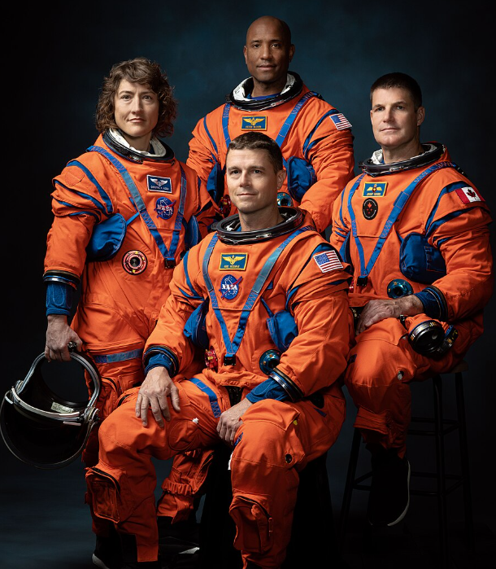
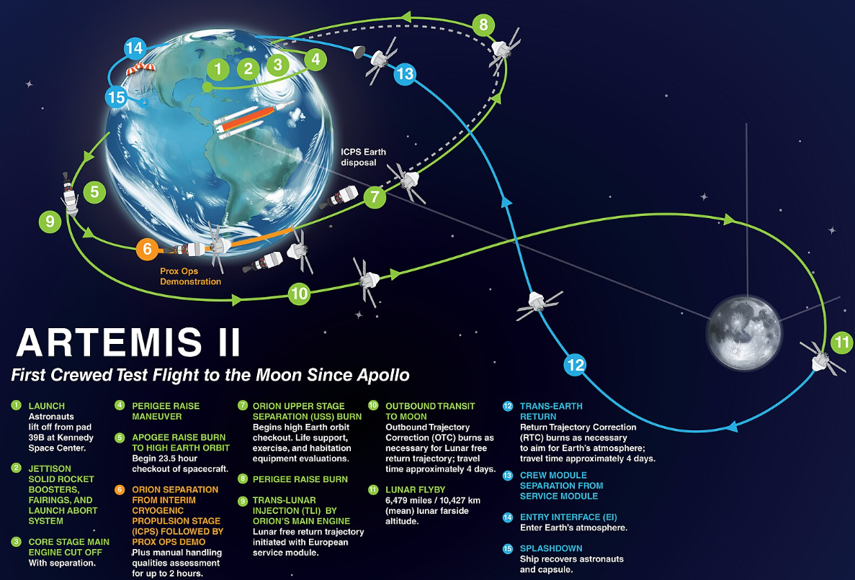
MISSION OVERVIEW
The ARTEMIS-II mission is NASA’s first crewed Orion flight in the Artemis program, launched April 1, 2026, with a ~9-day translunar trajectory.

Slide 3
DSES INVOLVMENT
The DSES station is one of 39 ground stations worldwide selected to track the ARTEMIS-II Orion spacecraft and record Doppler data.
The DSES station conducted passive one-way Doppler tracking of the Orion spacecraft carrier signal during multiple tracking windows between:
April 4, 2026 April 8, 2026 April 9, 2026
Tracking was performed using:
18.2 m parabolic dish (f/D = 0.42)
Low-noise S-band front-end (~0.5 dB NF)
SDR platform (USRP / B200/B210)
Rubidium 10 MHz reference

Slide 4
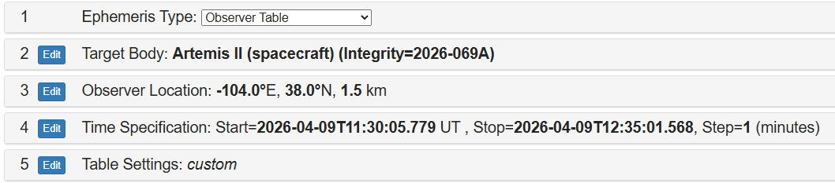
MEASUREMENT METHODS
Reference Data
JPL Horizons ephemeris (range & range-rate) used as truth model
Signal Processing Chain
Center frequency near: 2216.5 MHz
FFT-based spectral processing
Doppler extraction via: - Peak detection - Quadratic interpolation - Optional centroid/phase methods
Output Format - CCSDS TDM v2.0 - Observable:
LINK: https://ssd.jpl.nasa.gov/horizons/app.html#/
RECEIVE_FREQ_2 = Doppler offset (Hz)
All scripts were written in python and available for everyone.

Slide 5
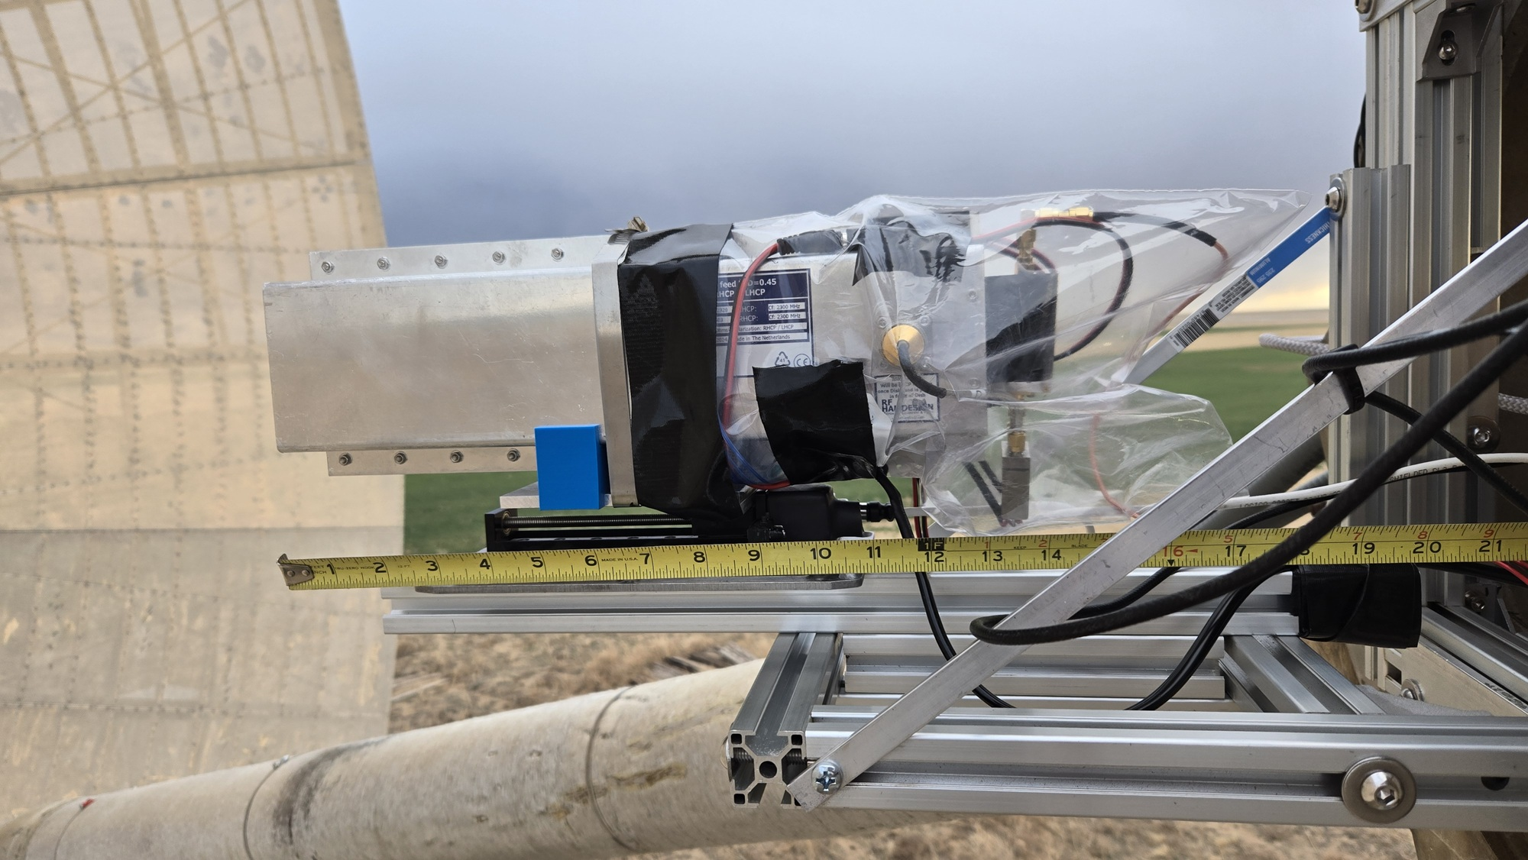
DISH FEED ANTENNA & LNA

Slide 6
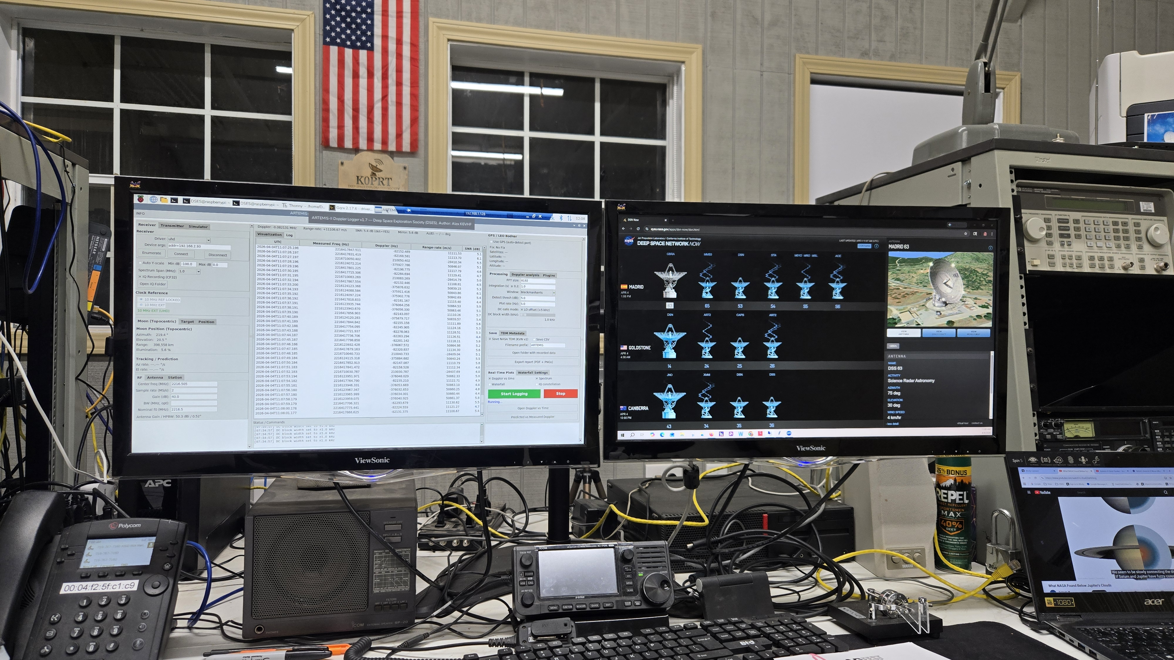
MAIN OPERATING CONSOLE

Slide 7
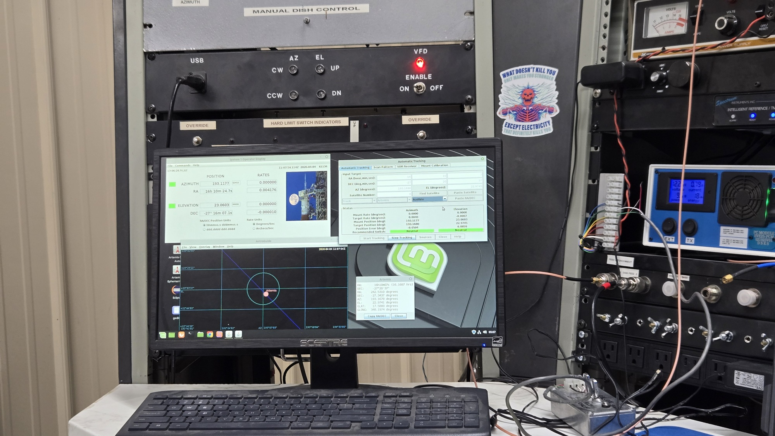
ANTENNA TRACKING CONSOLE

Slide 8
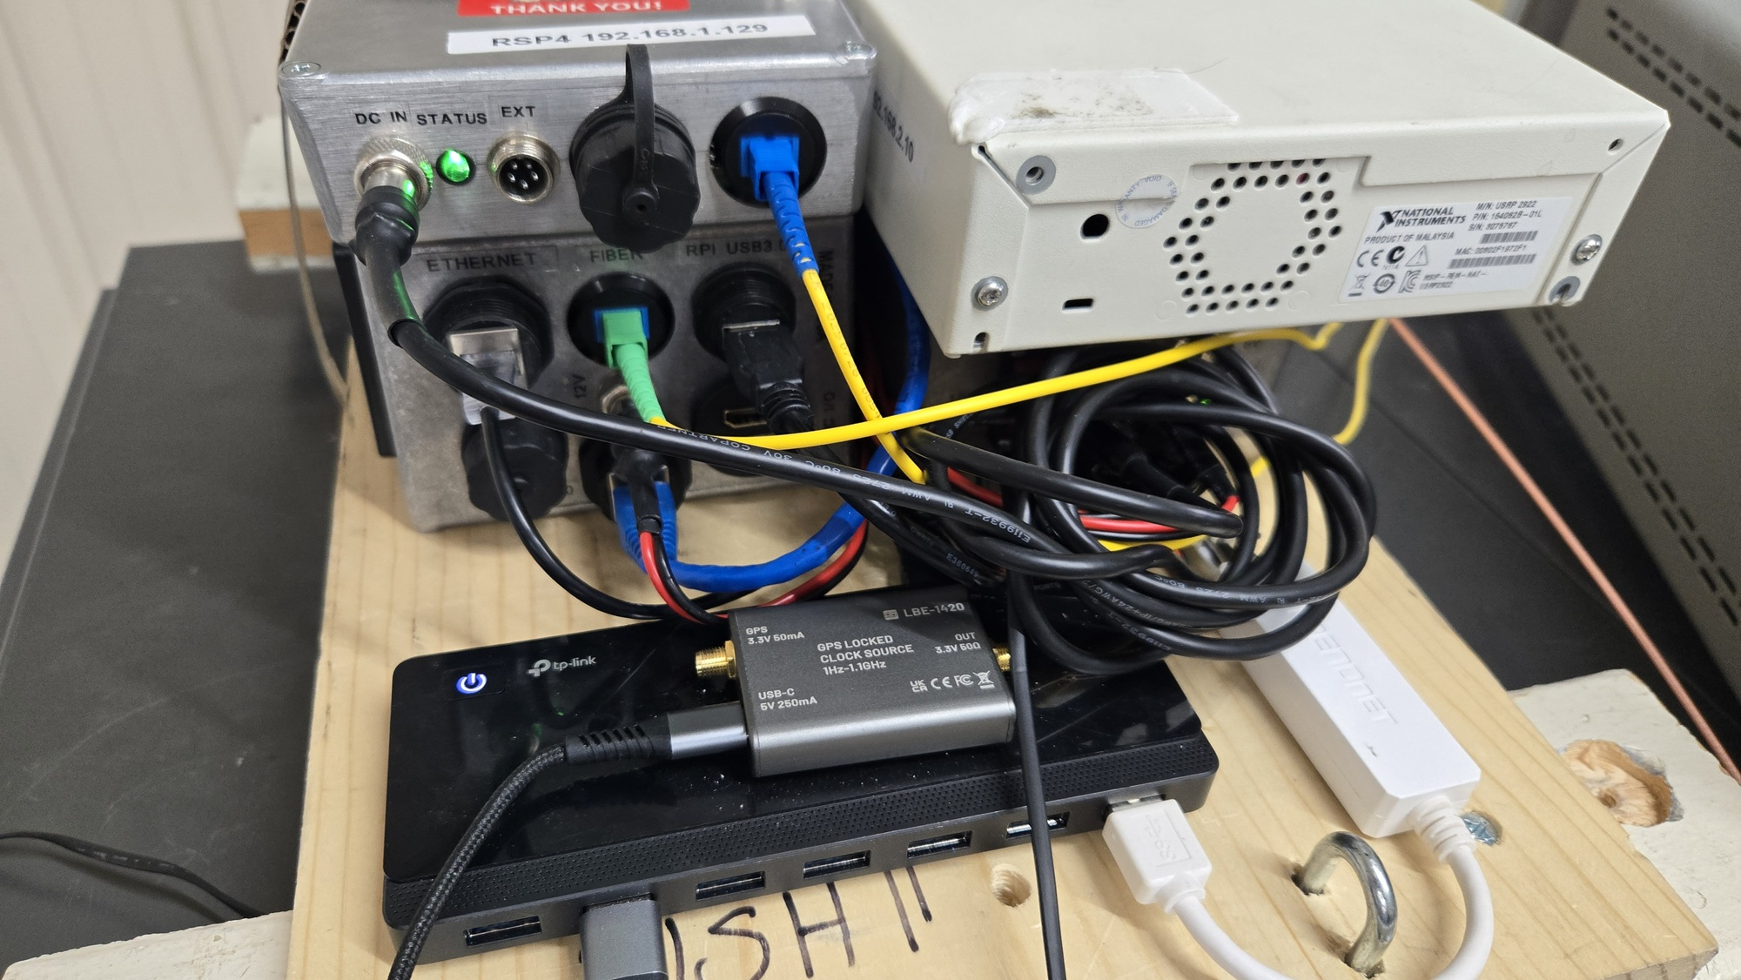
EQUIPMENT USED

Slide 9
SUMMARY OF RECORDED DATA
Total of 14.04 hours of data was recorded throughout all nights.
2026-04-04 (the longest session) → 8.04 hours
2026-04-04 (second session) → 0.45 hours
2026-04-08 → 2.31 hours
2026-04-09 (early session) → 2.16 hours
2026-04-09 (later session) → 1.08 hours

Slide 10
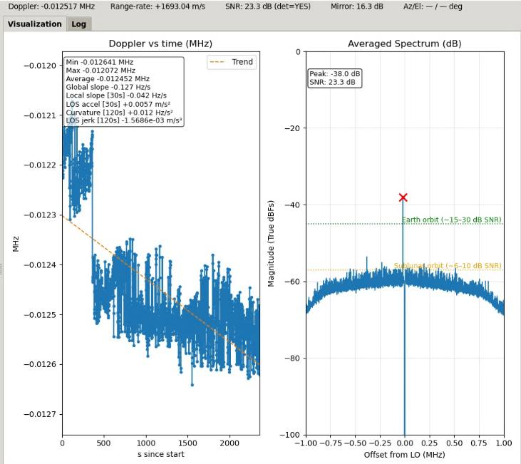
FIRST DETECTION
First detected signal from ORION spacecraft was observed on 04-04-2026 at 06:28:39 UTC (00:28:39 MST)
Carrier signal
The SNR was 23.3dB with peak up to 26dB, stable and easily trackable.
The measured Doppler shift was -7.517kHz with reassured transmitted frequency of 2216.492483 MHz

Slide 11
OBSERVATION RESULTS
Signal Detection
- Strong, continuous carrier lock
- No major dropouts
- Stable SNR across most integrations
Doppler Behavior
Across all sessions:
- Doppler exhibits smooth monotonic drift
- Typical drift rate:
~ +0.04 to +0.05 Hz/s
Matches expected:
Increasing radial velocity from Earth
Translunar trajectory dynamics
The highest SNR recorded 26dB The lowest SNR recorded 16dB
Furthest point was ~ 355,000km

Slide 12
SUMMARY OF RECORDED DATA
April 4th Data
Noise: 41–136 Hz
Drift: –30 to –600 Hz
Timing jitter: ~10–25 ms
April 8th Data
Noise: ~170 Hz
Drift: –622 Hz
Timing jitter: ~0.8 sec
April 9th Data
Noise: ~135-145 Hz
Drift: –386 to -531 Hz
Timing jitter: ~27-28 ms

Slide 13
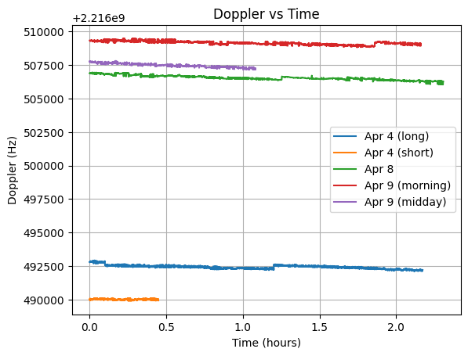
DATA QUALITY ASSESMENT
Strengths
1. Excellent Doppler slope fidelity
Measured slope matches JPL predictions very closely
Indicates:
Correct frequency reference scaling
Proper Doppler extraction logic
2. High temporal continuity
Continuous tracking across sessions
Minimal gaps
3. Low random noise
Doppler jitter is small
Suitable for:
Velocity estimation
Residual analysis

Slide 14
ISSUES IDENTIFIED
Baseline Offset Discontinuities
Sudden jumps (~50–150 Hz)
Then recovery to original trend
Interpretation:
NOT physical Doppler
Instrument/system-induced
Likely causes:
SDR LO retuning or reinitialization
Reference (10MHz) phase reset
Peak-tracking ambiguity
DC notch interaction
Segment-dependent bias
Each continuous segment has:
- Internally consistent slope
- But different absolute offset
Indicates:
Reference drift OR
Tracking reacquisition bias
dominant systematic error

Slide 15
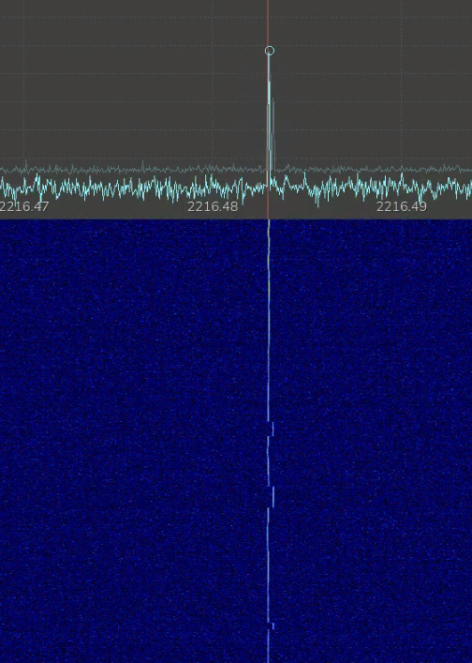
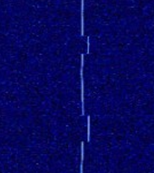
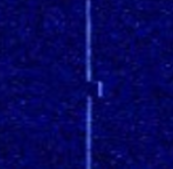
ERROR VISUALIZATION USING GQRX
ORION CARRIER
Recorded RAW IQ DATA

Slide 16
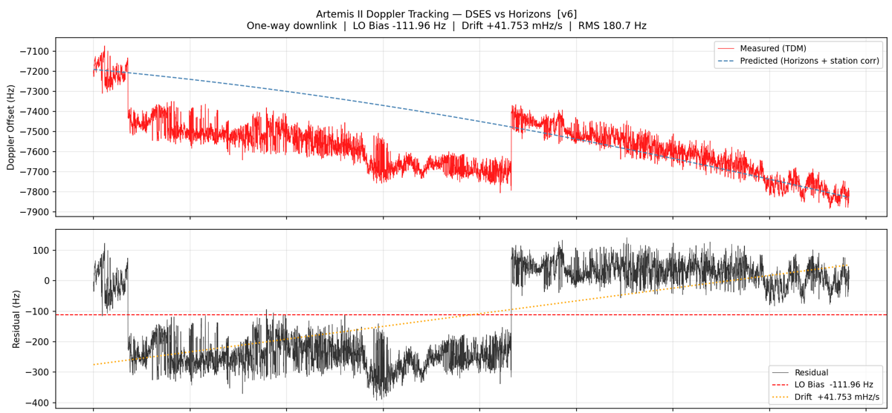
EXAMPLE OF DOPPLER EXTRACTION

Slide 17
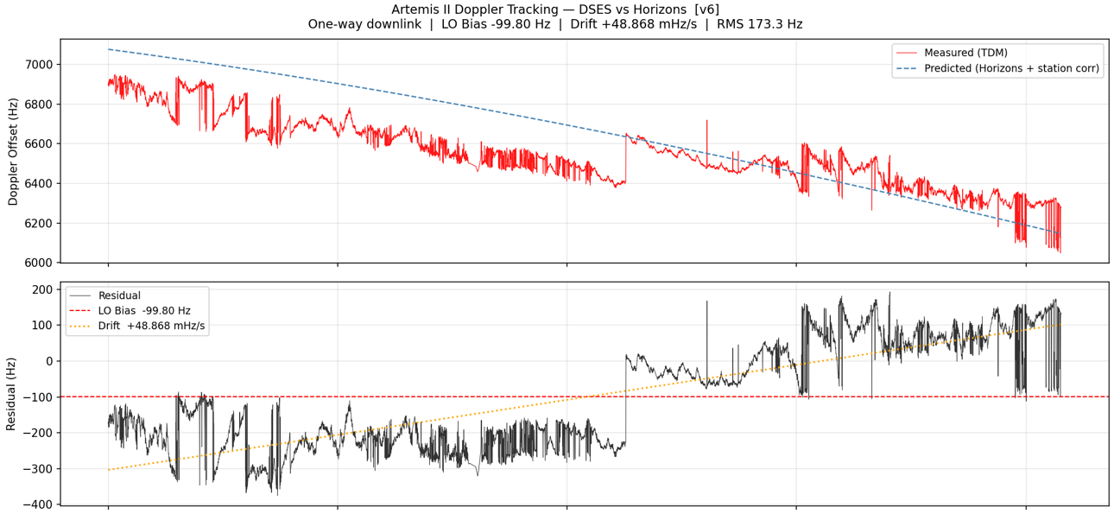
ANOTHER EXAMPLE

Slide 18
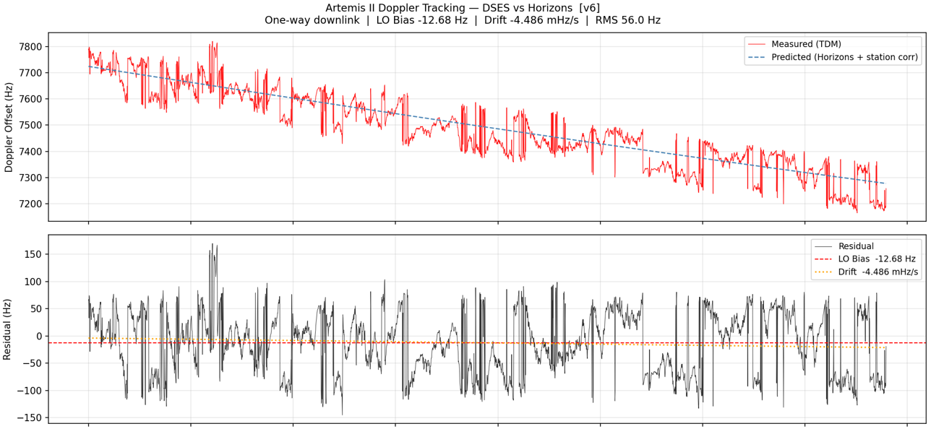
EXAMPLE OF GOOD DATA

Slide 19
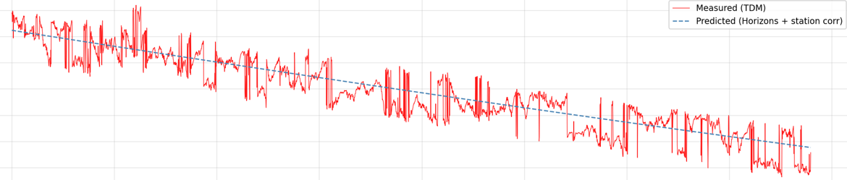
COMPARISON WITH JPL PREDICTION
Using Horizons ephemeris:
- Range-rate increases smoothly (positive acceleration)
- Measured Doppler slope matches:
Agreement:
- Trend
- Curvature
- Sign
Discrepancy:
Absolute offset varies between segments

Slide 20
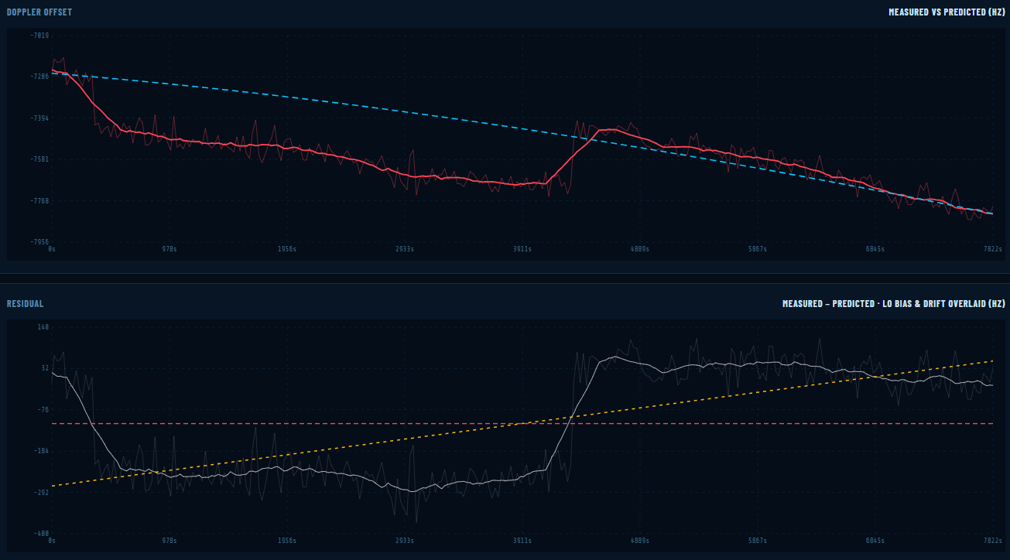
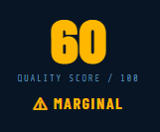
APRIL 4th DOPPLER DATA
APRIL 4th DATA

Slide 21
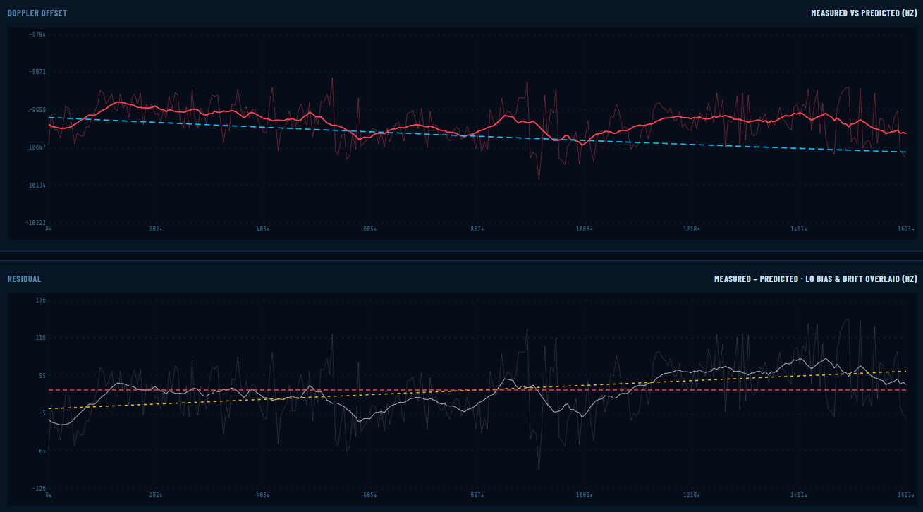
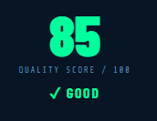
APRIL 4th DOPPLER DATA
APRIL 4th DATA
APRIL 4th DATA

Slide 22
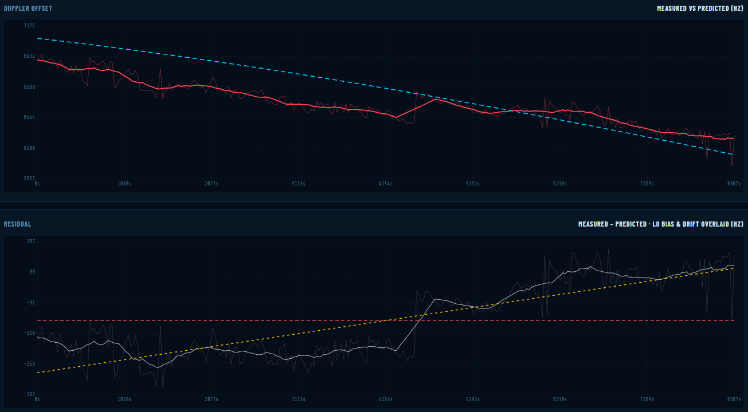
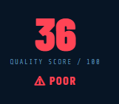
APRIL 4th DOPPLER DATA
APRIL 4th DATA
APRIL 4th DATA
APRIL 8th DATA

Slide 23
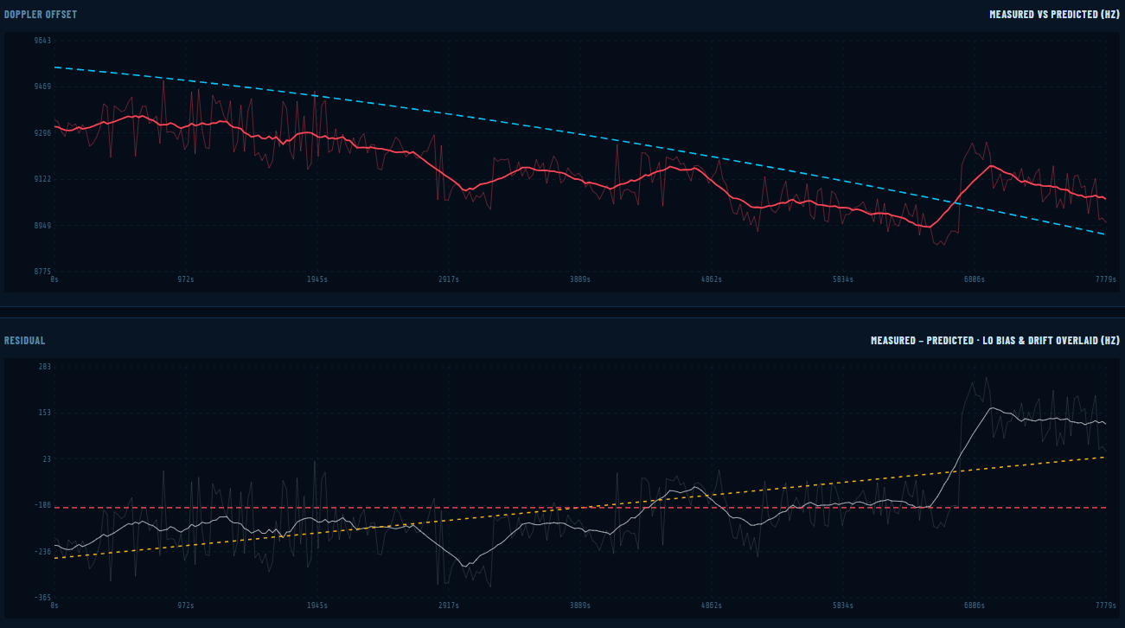
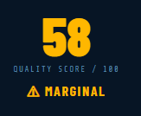
APRIL 4th DOPPLER DATA
APRIL 4th DATA
APRIL 4th DATA
APRIL 8th DATA
APRIL 9th DATA

Slide 24
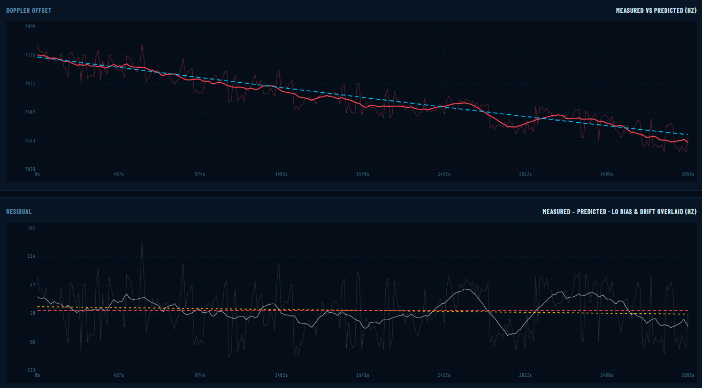
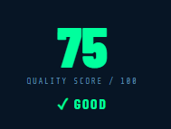
APRIL 4th DOPPLER DATA
APRIL 4th DATA
APRIL 4th DATA
APRIL 8th DATA
APRIL 9th DATA
APRIL 9th DATA

Slide 25
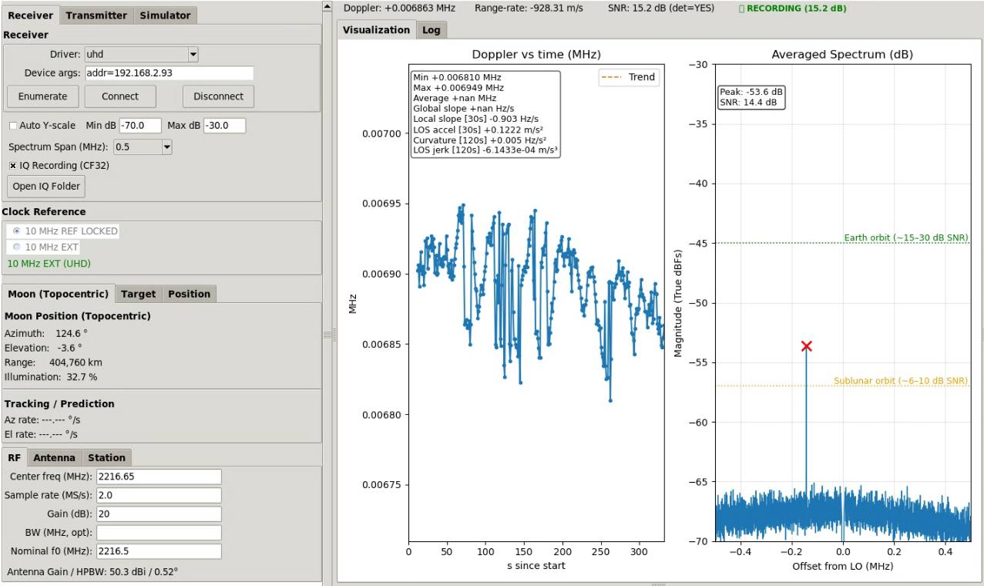
ARTEMIS-II DOPPLER LOGGER

Slide 26
OUTPUT FORMAT CCSDS TDM v2.0
CCSDS_TDM_VERS = 2.0 ORIGINATOR = DSES CREATION_DATE = 2026-04-04T14:31:18.160Z META_START TIME_SYSTEM = UTC PARTICIPANT_1 = ORION PARTICIPANT_2 = DSES MODE = SEQUENTIAL PATH = 1,2 INTEGRATION_INTERVAL = 1.000000 INTEGRATION_REF = END FREQ_OFFSET = 2216500000.000 START_TIME = 2026-04-04T06:28:39.890Z STOP_TIME = 2026-04-04T14:31:17.159Z TURNAROUND_NUMERATOR = 240 TURNAROUND_DENOMINATOR = 221 META_STOP
DATA_START RECEIVE_FREQ_2 = 2026-04-04T06:28:39.890Z 2216492804.299 RECEIVE_FREQ_2 = 2026-04-04T06:28:40.152Z 2216492791.508 RECEIVE_FREQ_2 = 2026-04-04T06:28:40.566Z 2216492796.558 RECEIVE_FREQ_2 = 2026-04-04T06:28:40.909Z 2216492780.814 RECEIVE_FREQ_2 = 2026-04-04T06:28:41.226Z 2216492776.523 RECEIVE_FREQ_2 = 2026-04-04T06:28:41.400Z 2216492792.109 RECEIVE_FREQ_2 = 2026-04-04T06:28:41.683Z 2216492806.615 RECEIVE_FREQ_2 = 2026-04-04T06:28:41.940Z 2216492780.829 RECEIVE_FREQ_2 = 2026-04-04T06:28:42.198Z 2216492776.729 RECEIVE_FREQ_2 = 2026-04-04T06:28:42.456Z 2216492774.341 DATA_STOP

Slide 27
OVERALL DATA QUALITY
Metric | Rating
Doppler slope accuracy | ⭐⭐⭐⭐⭐ (Excellent)
Noise / stability | ⭐⭐⭐⭐☆ (Very good)
Continuity | ⭐⭐⭐⭐☆ (Very good)
Absolute accuracy | ⭐⭐☆☆☆ (Poor)
DSN-grade usability | ⭐⭐⭐☆☆ (Good)
“This is a first-of-its-kind DSES effort”

Slide 28
KEY TECHNICAL INSIGHT
This dataset shows:
Our system is dynamically correct but not absolutely referenced continuously
Meaning:
Physics = correct
Measurement = precise
Reference = discontinuous (that include software and hardware)

Slide 29
SCIENTIFIC VALUE
Despite offset issues, this dataset is:
Valid for:
- Doppler slope / velocity estimation
- Trajectory verification
- Educational DSN-style experiments
Limited for:
- Absolute frequency comparison
- High-precision orbit determination

Slide 30
FINAL CONCLUSION
The ARTEMIS-II Doppler tracking campaign demonstrates:
High-quality Doppler tracking capability with excellent dynamic fidelity, limited primarily by reference discontinuities rather than signal or processing limitations.
With minor improvements, our system can reach:
Near-DSN-quality Doppler performance

Slide 31
QUESTIONS ?

